Slide 1

Normalization
Functional Dependency
Attribute Closure
Data Normalization

Slide 2
Functional Dependency and Attribute Closure
Functional Dependency
A functional dependency A->B in a relation holds if two tuples having same value of attribute A also have same value for attribute B. For
EX: STUDENT relation has the following functional dependencies
These dependencies hold
ST_ID->ST_NAME,
ST_ID->ST_PHONE
But not this
ST_NAME->ST_ADDR
A -> B : Attribute A determines Attribute B or Attribute B is functionally dependent on Attribute A.
For A there can only every be one value of B.
If ST_ID is 4 then ST_Name is always John

Slide 3
Student Relation
ST_ID | ST_NAME | ST_PHONE | ST_STATE | ST_COUNTRY | ST_AGE
1 | Chris | 940-206-2345 | Texas | USA | 20
2 | Melanie | 940-206-2346 | New York | USA | 18
3 | Stephnie | 940-206-2347 | California | USA | 19
4 | John | 940-206-2348 | Tennessee | USA | 21
5 | Kumar | 940-206-2349 | Arkansas | USA | 20

Slide 4
How to find functional dependencies for a relation?
Specific to the domain
ST_ID is unique and hence
ST_ID->ST_NAME,
ST_ID->ST_PHONE,
ST_ID->ST_STATE,
ST_ID->ST_COUNTRY and
ST_ID -> ST_AGE
all hold
How about this?
ST_STATE->ST_COUNTRY
also hold
ST_ID | ST_NAME | ST_PHONE | ST_STATE | ST_COUNTRY | ST_AGE
1 | Chris | 940-206-2345 | Texas | USA | 20
2 | Melanie | 940-206-2346 | New York | USA | 18
3 | Stephnie | 940-206-2347 | California | USA | 19
4 | John | 940-206-2348 | Tennessee | USA | 21
5 | Kumar | 940-206-2349 | Arkansas | USA | 20
Functional dependency set – all the functional dependencies

Slide 5
Functional Dependency Set (FD)
Set of all FDs present in the relation
{ ST_ID->ST_NAME, ST_ID->ST_PHONE, ST_ID->ST_STATE,
ST_ID->ST_COUNTRY, ST_ID -> ST_AGE, ST_STATE->ST_COUNTRY }

Slide 6
More on FD
An attribute is functionally dependent if its value is determined by another attribute which is a key.
That is, if we know the value of one (or several) data items, then we can find the value of another (or several).
• Functional dependencies are expressed as X → Y, where X is the determinant and Y is the functionally dependent attribute.
• If A →(B,C) then A → B and A → C.
• If (A,B) → C, then it is not necessarily true that A → C and B → C.
• If A → B and B → A, then A and B are in a 1-1 relationship.
• If A → B then for A there can only ever be one value for B.

Slide 7
Transitive Dependencies (TD)
An attribute is transitively dependent if its value is determined by another attribute which is not a key.
• If X → Y and X is not a key then this is a transitive dependency.
• A transitive dependency exists when A → B → C but NOT A → C.

Slide 8
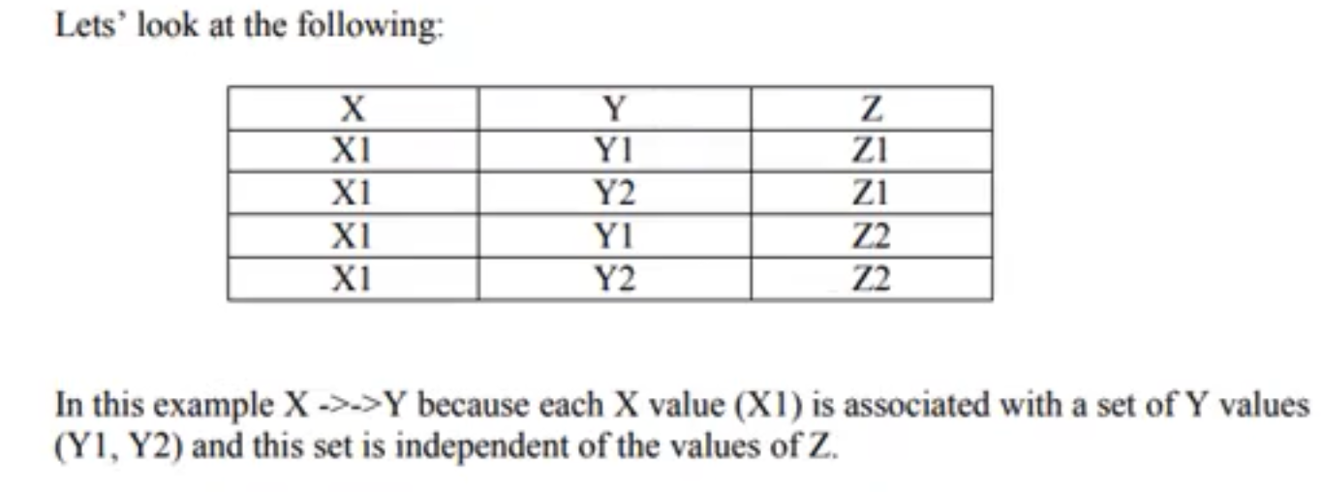
Multi-Valued Dependencies (MVD)
A table involves a multi-valued dependency if it may contain multiple values for an entity.
X→Y, i.e. X multi-determines Y, when for each value of X we can have more than one value of Y.
X ->>-Y

Slide 9
Attribute Closure – (attribute)+
Set of attributes which can be functionally determined from it
How to find attribute closure of an attribute set?
Add elements of attribute set to the result set
Recursively add elements to the result set which can be functionally determined from the elements of the result set
Using the FD set of the table (Student)
(ST_ID)+ = {ST_ID, ST_NAME, ST_PHONE, ST_STATE, ST_COUNTRY, ST_AGE} (ST_STATE)+ = {ST_STATE, ST_COUNTRY}
Using ST_ID we can find all these
If attribute closure of an attribute contains all the attributes of the entity then it is super key / candidate key.

Slide 10
Use attribute closure to find candidate and super keys
If attribute closure of an attribute set contains all attributes of relation, the attribute set will be super key of the relation.
Is the ST_ID a super key?
(ST_ID)+ = {ST_ID, ST_NAME, ST_PHONE, ST_STATE, ST_COUNTRY, ST_AGE}
If no subset of this attribute set can functionally determine all attributes of the relation, the set will be candidate key as well
If it is minimal then the super key can be candidate key. In this case it is candidate key.

Slide 11
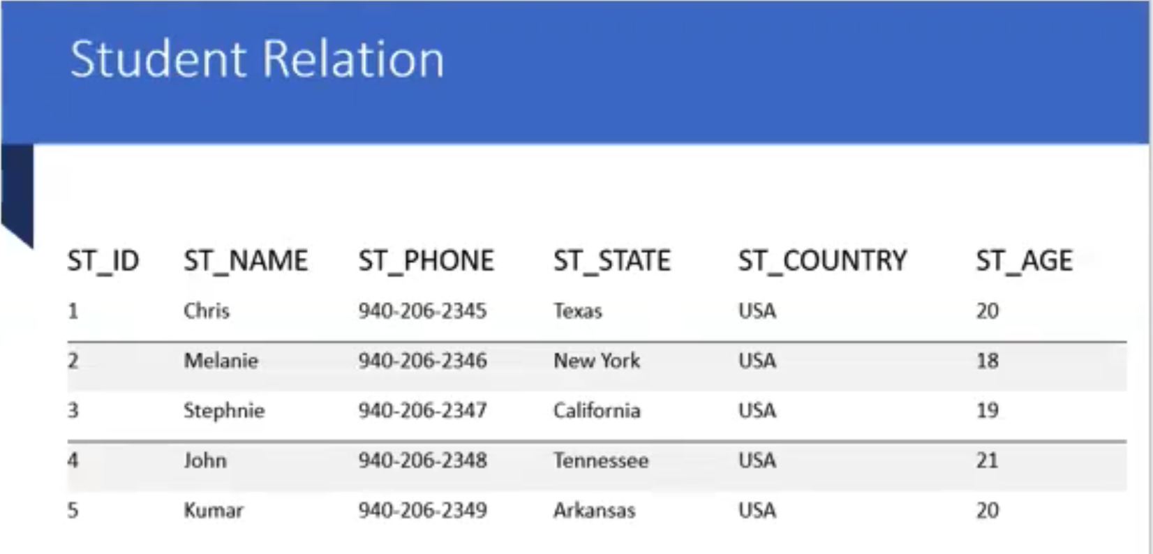
Use attribute closure to find candidate and super keys
If no subset of this attribute set can functionally determine all attributes of the relation, the set will be candidate key as well.
(ST_ID, ST_NAME)+ = {ST_ID, ST_NAME, ST_PHONE, ST_STATE, ST_COUNTRY, ST_AGE}
This is a super key
Is the (ST_ID, ST_NAME) candidate key?
No, its not candidate key.
ST_ID is the candidate key.

Slide 12
Use attribute closure to find candidate and super keys
(ST_ID, ST_NAME) is a super key but not candidate key because its subset (ST_ID)+ is equal to all attributes of the relation. So, ST_ID will be a candidate key.

Slide 13
Candidate key example
R = {E, F, G, H, I, J, K, L, M, M} and
the set of functional dependencies
{{E, F} -> {G}, {F} -> {I, J}, {E, H} -> {K, L}, K -> {M}, L -> {N} on R.
What is the key for R?
1. {E, F} 2. {E, F, H} 3. {E, F, H, K, L} 4. {E}

Slide 14
Answer:
Finding attribute closure of all given options, we get: {E,F}+ = {EFGIJ} {E,F,H}+ = {EFHGIJKLMN} {E,F,H,K,L}+ = {{EFHGIJKLMN} {E}+ = {E}
{EFH}+ and {EFHKL}+ results in set of all attributes
EFH and EFHKL are super keys
EFH is minimal
It is the candidate key, Answer is 2

Slide 15
Another Example
FD E-ID->NAME holds
because for each E-ID, there is a unique value of NAME.
FD E-ID->CITY and CITY->STATE also holds.
FD NAME->E-ID does not hold
because E-NAME ‘John’ is not uniquely determining E-ID. There are 2 E-IDs corresponding to John (E001 and E003).
E-ID | NAME | CITY | STATE
E001 | John | Denton | Texas
E002 | Mary | Dallas | Texas
E003 | John | New York | New York

Slide 16
FDs of the Employee table
{ E-ID->NAME, E-ID->CITY, E-ID->STATE, CITY->STATE }
Find (E-ID)⁺

Slide 17
Prime and non-prime attributes
An attribute is a part of a candidate key -> prime attribute
{E-ID->NAME, E-ID->CITY, E-ID->STATE, CITY->STATE}
What is the prime attribute?
Define non-prime attributes
Attributes that are not a part of the candidate key. -> NAME, CITY, STATE

Slide 18
Properties of Functional Dependencies
Let X, Y, and Z are sets of attributes in a relation R.
There are several properties of functional dependencies which always hold in R also known as Armstrong Axioms.
Reflexivity: If Y is a subset of X, then X → Y
{ST_ID, ST_NAME} -> {ST_ID}
Augmentation: If X → Y, then XZ → YZ
{ST_ID,ST_NAME} -> {ST_ID} => {ST_ID,ST_NAME, ST_CITY} -> {ST_ID, ST_CITY}
Transitivity: If X → Y and Y → Z, then X → Z
{ST_ID} -> {ST_CITY} and {ST_CITY} ->{ST_STATE} then {ST_ID} -> {ST_STATE}

Slide 19
Normalization
1st Normal Form
2nd Normal Form
3rd Normal Form
Boyce-Codd Normal Form - BCNF (3.5 Normal Form)
Normal forms that we do not discuss
4th Normal Form
5th Normal Form

Slide 20
Why do we normalize?
We normalize to reduce data redundancy
That causes
Update anomalies – Data is duplicated in several places, one gets updated – Ex: Branch and Branch_ID
Delete anomalies – Delete one record, part of it is in another table/ delete other records
such as department from the system when deleting an employee – Ex: If Stephanie leaves the university, only she is in PHY dept. So we loss all data related to PHY department.
Insert anomalies – Insert data, but the related data is not in the database (referencing)
EMP_ID | NAME | Address | BRANCH | BRANCH_ID
1 | John | Dallas TX | CSE | 10
2 | Kumar | Denton TX | CSE | 10
3 | Ravi | Boston MA | CSE | 10
4 | Stephanie | New York NY | PHY | 11
5 | Jayantha | Flower Mound TX | CSE | 10

Slide 21
1st Normal Form
Dealing with multi-valued attributes
All the attributes must be atomic
Product
Product_Price
Product_Color
PRODUCT_ID | COLOR | PRICE
1 | Red, Green | $100
2 | Pink | $55
3 | Blue, Purple | $20
4 | Yellow | $75
PRODUCT_ID | PRICE
1 | $100
2 | $55
3 | $20
4 | $75
PRODUCT_ID | COLOR
1 | Red
1 | Green
2 | Pink
3 | Blue
3 | Purple
4 | Yellow

Slide 22
2nd Normal Form
A table is said to be in 2NF if both the following conditions hold:
Table is in 1NF (1st normal form)
No non-prime attribute is dependent on the proper subset of any candidate key of table.
An attribute that is not part of any candidate key is known as non-prime attribute.

Slide 23
2nd Normal Form Cont’d
How about the Store_Id -> store_Location?
Store_Location is a non-prime attribute
What is the primary key?
Sales
Customer_Id | Store_Id | Store_Location
1 | 1 | Dallas
1 | 2 | Denton
2 | 1 | Dallas

Slide 24
2nd Normal Form Cont’d
Split the table
Sales
Store_Location
Customer_Id | Store_Id
1 | 1
1 | 2
2 | 1
Store_Id | Store_Location
1 | Dallas
2 | Denton

Slide 25
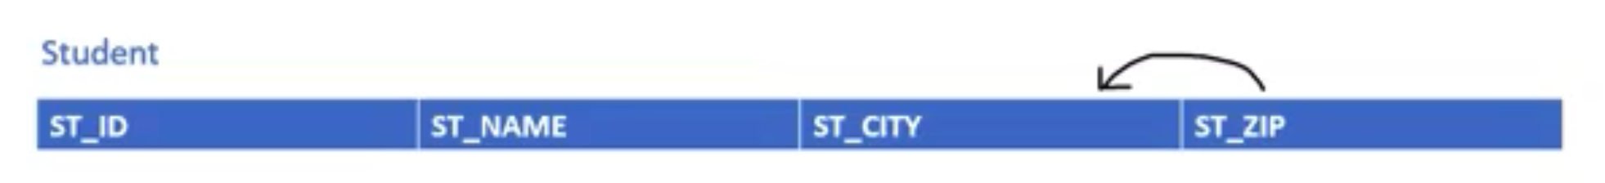
3rd Normal Form
A table design is said to be in 3NF if both the following conditions hold:
Table must be in 2NF
Transitive functional dependency of non-prime attribute on any super key should be removed.
An attribute that is not part of any candidate key is known as non-prime attribute.
A table is in 3NF if it is in 2NF and for each functional dependency X-> Y at least one of the following conditions hold:
X is a super key of table
Y is a prime attribute of table
An attribute that is a part of one of the candidate keys is known as prime attribute.

Slide 26
3rd Normal Form Cont’d
Student
ST_ID | ST_NAME | ST_CITY | ST_ZIP
Do these conditions hold?
Zip is a super key of table -> No
City is a prime attribute of table -> No
Student table is not in 3rd normal form
The only prime attribute is the ST_ID

Slide 27
3rd Normal Form Cont’d
Student
ST_ID | ST_NAME | ST_ZIP
City
CITY | ZIP

Slide 28
Boyce-Codd Normal Form
Boyce-Codd Normal Form (BCNF) is an extension of Third Normal Form on strict terms. BCNF
states that −
For any non-trivial functional dependency, X → A, X must be a super-key.
In the above image, ST_ID is the super-key in the relation Student and Zip is the super key to the relation City. So,
ST_ID → ST_NAME, ZIP
and
ZIP → CITY
Which confirms that both the relations are in BCNF.
If a functional dependency X-> Y holds true when Y is not a subset of X then this dependency is called non-trivial Functional dependency.
(X,Y) -> Y : Trivial functional dependency.
(X,Y) -> Z: Non-trivial functional dependency

Slide 29
3rd and BCNF
ST_ID | ST_NAME | ST_ZIP
CITY | ZIP

